Slide 1




overall_1_132573879104528179 columns_1_132573879104528179
Microsoft Office Add-ins
Community call
Working with Partial Documents in PowerPoint
Content control enhancements in Word Online
Search Bar for Office Add-ins
November 9, 2022

Slide 2
Agenda
John Teichman
Onur Onder
Maja Damjanic
Adrian Wu
Principal Product Manager
Sr. Software Engineer
Senior Product Manager
Senior Product Manager

Slide 3
Working with Partial Documents in PowerPoint
John Teichman: Principal Product Manager Onur Onder: Senior Software Engineer

Slide 4
Partial Docs Rationale
PPT File Sizes are growing exponentially
Download speeds not keeping up
The largest part of PPT files are videos/images
Necessitates a new approach - partial docs
2021 File Size | Download Speed | Download Time
319 MB | 29.91 Mbps (Mobile) | 89.2s
319 MB | 60.76 Mbps (Fixed) | 43.9s
Global Median Speeds Feb 2022

Slide 5



Partial Documents explained with your favorite cheeses
In the database
Open and Edit Fast!
Holes fill in while you work!
Document in parts
Functional Presentation
Full Presentation
Partial Docs make opening & coauthoring large presentations as performant as small presentations:
Documents load quickly while media downloads in the background
Time to edit, collaborate and present is substantially improved
Co-auth performance and stability is enhanced

Slide 6
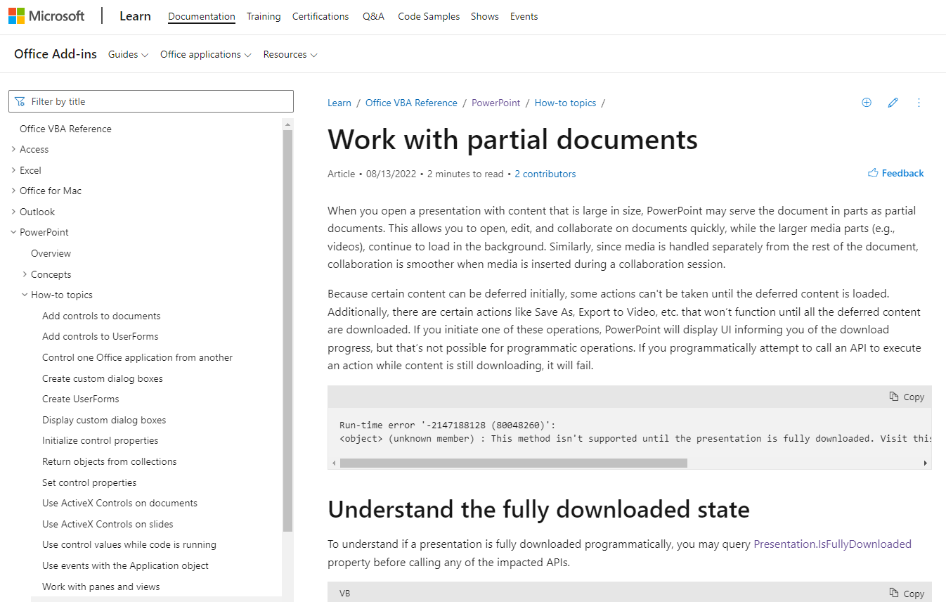
Working with Partial Documents Documentation
https://learn.microsoft.com/office/vba/powerpoint/how-to/work-with-partial-documents

Slide 7
Presentation.IsFullyDownloaded
https://learn.microsoft.com/office/vba/api/powerpoint.presentation.isfullydownloaded
If ActivePresentation.IsFullyDownloaded Then
MsgBox "Presentation is downloaded."
Else
MsgBox "PowerPoint is still downloading the presentation."
End If

Slide 8
Error Handling
Sub TestCopySlide()
On Error GoTo eh
ActivePresentation.Slides(1).Copy
Exit Sub
eh:
If Err.Number = -2147188128 Then
MsgBox "Cannot copy because the presentation is not fully downloaded.“
Else
MsgBox "Failure is due to a reason other than incomplete download: " & Err.Description
End If
Debug.Print Err.Number, Err.Description
End Sub

Slide 9
Impacted APIs – Com/VBA
Following is a list of impacted OM API calls which may return the error code:
Name
Presentation.Export
Presentation.ExportAsFixedFormat
Presentation.ExportAsFixedFormat2
Presentation.SaveAs
Presentation.SaveCopyAs
Presentation.SaveCopyAs2
Presentation.Password
Presentation.WritePassword
Selection.Copy
Selection.Cut
Shape.Copy
Shape.Cut
ShapeRange.Cut
ShapeRange.Copy
Shapes.Paste
Shapes.PasteSpecial
Slide.Copy
Slide.Cut
Slide.Export
SlideRange.Copy
SlideRange.Cut
SlideRange.Export
Slides.Paste
CustomLayouts.Paste
View.Paste
View.PasteSpecial
MediaFormat.Resample
MediaFormat.ResampleFromProfile
Player.Play

Slide 10
Impacted APIs – Office.JS
Following is a list of impacted Office-JS API calls which may return with an error:
Name
Office.Document.getFileAsync
* Office.JS documentation will be updated along with the upcoming changes

Slide 11
PowerPoint Partial Documents Feedback
Reach out to:
pptpartialdocsfdbk@microsoft.com

Slide 12
Content control enhancements in Word Online
Maja Damjanic: Senior Product Manager

Slide 13
Content controls in Word
Content controls are...
Entities that act as containers for specific content in a document
Ideal for creating structured documents
As of Word 2013, supported types:
Rich Text, Plain Text, Checkbox, Picture, Building Block, Combo Box, Dropdown List, Date/Calendar, Repeating Section
Creating content controls:
Through the Word UI, via Developer tab and ribbon
Programmatically, using COM/VBA or Office.JS*
Notes:
We know this is a large change and may possibly break existing com based add-ins, and thus we would like to give some heads up before it goes live.
If you have any concerns or any other feedback, you can send your comments and questions to this ppt partial docs feedback email address
Thanks for listening

Slide 14
Content controls in Word Online (summer 2022)
Viewing - all content control types added via Desktop client(s) will be displayed in Word Online
Editing - Partial support for editing of RichText content control
Programmatic access - working with RichText content control in Office.JS
Notes:
We know this is a large change and may possibly break existing com based add-ins, and thus we would like to give some heads up before it goes live.
If you have any concerns or any other feedback, you can send your comments and questions to this ppt partial docs feedback email address
Thanks for listening

Slide 15

What's new
Enhancements of RichText content control support
Select and delete operations parity with Word Desktop
Support for editing content controls inside tables
Support for editing of empty content controls
Support for editing/manipulating inline content controls
...and more
Support for PlainText content controls editing*
Notes:
We know this is a large change and may possibly break existing com based add-ins, and thus we would like to give some heads up before it goes live.
If you have any concerns or any other feedback, you can send your comments and questions to this ppt partial docs feedback email address
Thanks for listening

Slide 16

In the pipeline...
Enhancements of RichText and PlainText content control
Cut, copy and paste support
Hidden content controls
Track changes support for content controls
Notes:
We know this is a large change and may possibly break existing com based add-ins, and thus we would like to give some heads up before it goes live.
If you have any concerns or any other feedback, you can send your comments and questions to this ppt partial docs feedback email address
Thanks for listening

Slide 17

Let us know what you'd want to see next in this area:
aka.ms/WordAPI
Notes:
We know this is a large change and may possibly break existing com based add-ins, and thus we would like to give some heads up before it goes live.
If you have any concerns or any other feedback, you can send your comments and questions to this ppt partial docs feedback email address
Thanks for listening

Slide 18
Search Bar to locate Office Add-ins
Adrian Wu: Senior Product Manager

Slide 19
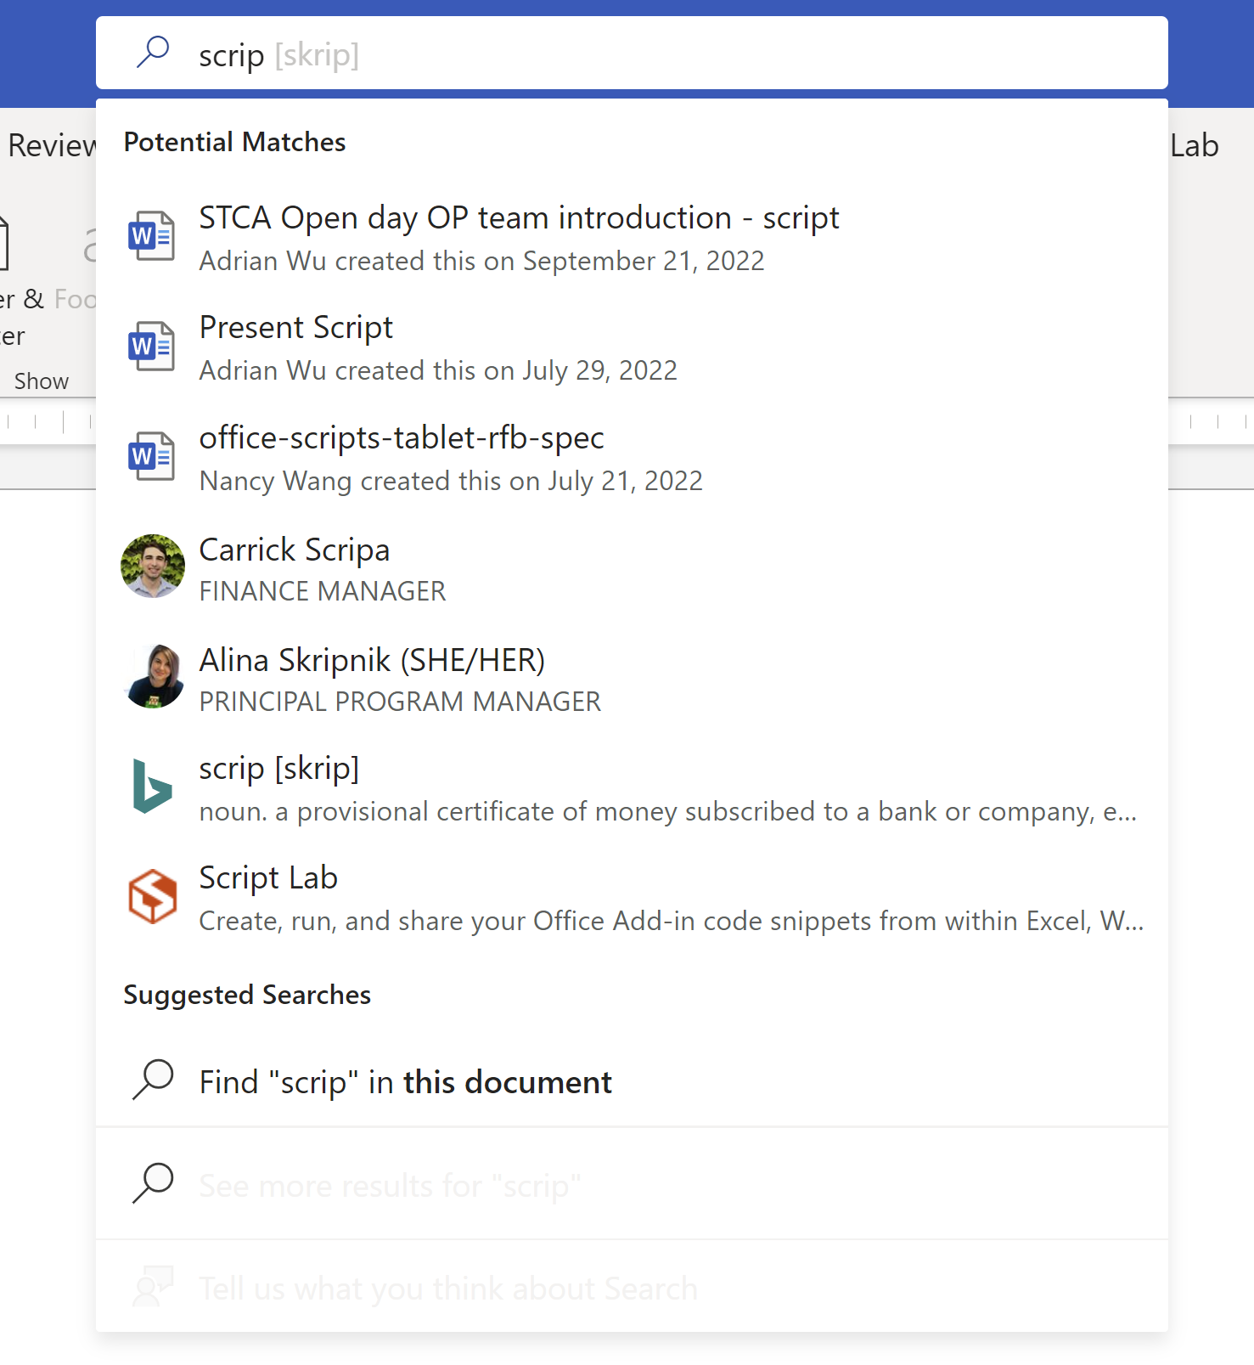



Search Add-in in the search box (TellMe)
Users can search for the installed add-ins from the search box on the top of the W/X/P
Supporting
Word
Excel
PowerPoint
Supporting
user installed add-ins
admin deployed add-ins
Keep releasing feature... starting from Word Online
Online / Window
Notes:
For the Office.JS side in PowerPoint, only one API is impacted at this time, and that is the getFileAsync call which returns the file itself, and it needs everything to be downloaded before it can return anything.
Also note that the Office.js documentation on this is not updated yet but will be coming up with the product changes.

Slide 20
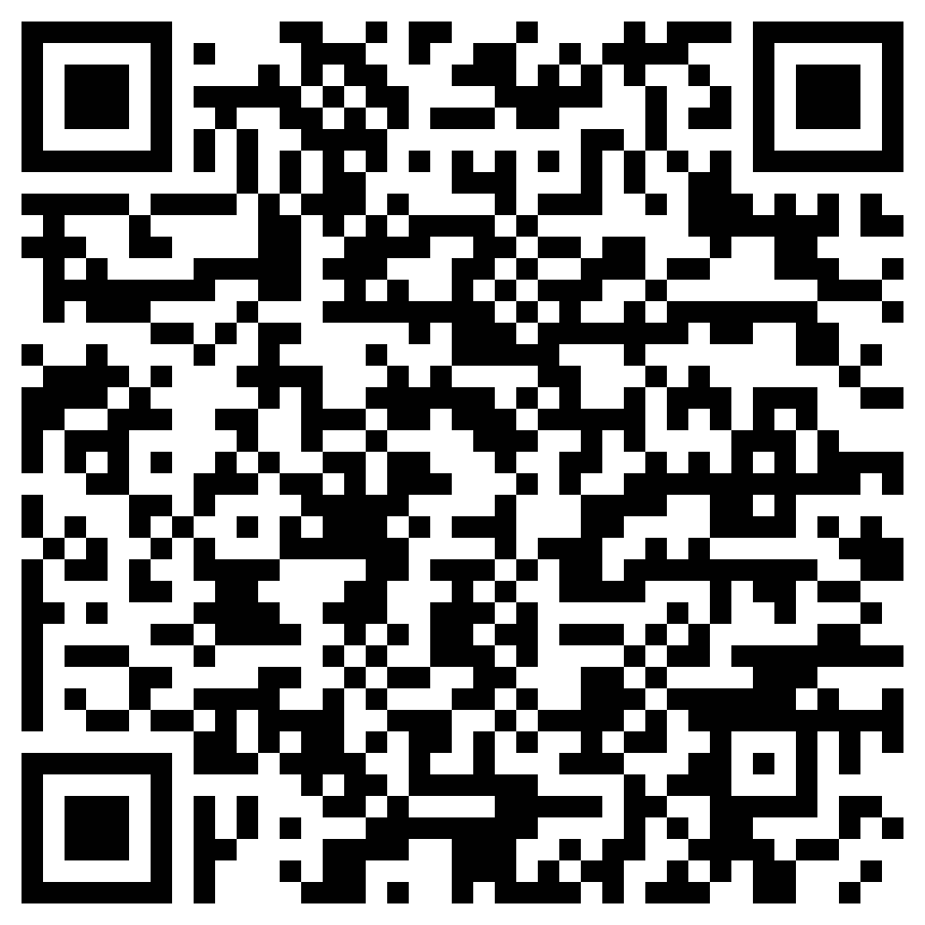
Experience Details
Configure a default task pane​
If your add-in only has only one task pane or had designated a default task pane
Click and launch task pane (recommended!!)
If your add-in has more than 1 task pane, and have no default task pane setting
Click and navigate to the Ribbon Tab
Automatically open a task pane when an add-in is installed - Office Add-ins | Microsoft Learn
Notes:
For the Office.JS side in PowerPoint, only one API is impacted at this time, and that is the getFileAsync call which returns the file itself, and it needs everything to be downloaded before it can return anything.
Also note that the Office.js documentation on this is not updated yet but will be coming up with the product changes.

Slide 21
Question:
My clients want my Outlook on-send add-in to be available in AppSource. AppSource currently does not allow on-send add-ins. When will AppSource accept on-send add-ins?
Answer:
Tracking down answer right now, will answer this in the blog post!
Q&A

Slide 22
Question:
I have enabled SSO by registering the App in AAD. From Outlook App it is getting authenticated and landing to the razor page (cshtml) - .Net core Web App with razor pages.
o When plugin opened up from Outlook App – redirected http://localhost:52808/MessageRead page with 302
o Redirected to login.microsftonline.com to authorize client and received 200 status, then redirected to call back path
o EOAService/signin-oidc – signed in and redirected to Message read page
o MessageRead page loaded with 200 status
the same when I open Outlook 365 from browser:
o When plugin opened up from Outlook App – redirected http://localhost:52808/MessageRead page with 302
o Redirected to login.microsftonline.com to authorize client and received 200 status, then redirected to call back path
o EOAService/signin-oidc – signed in and redirected to Message read page
o MessageRead page redirects to login.microsftonline.com
Is there any difference when loading from app and from browser??
Answer:
Tracking down answer right now, will answer this in the blog post!
Q&A

Slide 23






New to Office Add-ins?
 | Documentation | https://aka.ms/office-add-ins-docs
 | Quick starts | Outlook, Excel, Word, PowerPoint
 | Script Lab | https://aka.ms/getscriptlab
 | Samples | https://aka.ms/officeaddinsamples
 | Microsoft 365 Developer Program | https://aka.ms/M365devprogram
 | Office Scripts | aka.ms/office-scripts-docs
Notes:
m365-dev-sig

Slide 24
Engage with the team
Engagement | Where to go
Technical questions about Office Add-ins | https://aka.ms/office-addins-dev-questions [office-js-dev] [office-addins-dev] https://stackoverflow.com [office-js] [outlook-web-addins] [office-scripts]
Product bugs | https://github.com/OfficeDev/office-js
Feature requests and ideas | https://aka.ms/m365dev-suggestions
Send a Smile or Frown | Inside Office
Notes:
m365-dev-sig

Slide 25
Microsoft 365 developer community calls
Microsoft 365 platform call (weekly) https://aka.ms/m365-dev-call
Microsoft 365 & Power Platform Development (bi-weekly) https://aka.ms/m365-dev-sig
Viva Connections &
SharePoint Framework (bi-weekly) https://aka.ms/spdev-spfx-call
Adaptive Cards (monthly) https://aka.ms/adaptivecardscommunitycall
Microsoft identity platform (monthly) https://aka.ms/IDDevCommunityCalendar
Office Add-ins (monthly) https://aka.ms/officeaddinscommunitycall
Power Platform (monthly) https://aka.ms/PowerPlatformMonthlyCall
All calls and assets: https://aka.ms/m365pnp
Notes:
m365-dev-sig

Slide 26
Thank you
Recording will be available in 24 hours on
Microsoft 365 Community (PnP) YouTube channel
https://aka.ms/M365PnP/videos
(subscribe today)
Follow us on Twitter
@Microsoft365Dev | @M365PnP
Next call: December 14th at 8:00 AM Pacific Time
https://aka.ms/officeaddinscommunitycall
Agenda: https://aka.ms/officeaddinsagenda
Submit your questions: https://aka.ms/officeaddinsform

